Slide 1
Laws of Motion
Essential Question: How can we apply the Laws of Motion to explain the movement of objects on Earth?
AIM: Determining Speed
Date: February 26, 2013

Slide 2
Laws of Motion
Project Task:
To research, design and build an energy-efficient car.
What does energy-efficient mean in this lab?
An energy-efficient car will gain the most speed when racing down the track.

Slide 3
Laws of Motion
How do scientists and car engineers determine the speed of a vehicle?
Speed = Distance
Time

Slide 4
Laws of Motion
Example #1
A frog entered in a race takes 12 minutes to hop 35 feet. How fast did the frog hop?
Speed = Distance
Time

Slide 5
Laws of Motion
Example #2
The fastest train on Earth, the TGV from France, can travel extremely fast speeds. During a speed test, the train traveled 800 miles in 2.5 hours. What is its speed?
Speed = Distance
Time

Slide 6
Laws of Motion
How can we determine the speed of our control car?
Track Distance = 34 feet
If 1 meter = 3.28 feet, how many meters is the track?

Slide 7
Laws of Motion
Design a data table that will allow us to collect data on the speed of the control car over 3 trials

Slide 8
Laws of Motion
Gathering Data
 | Trial 1 | Trial 2 | Trial 3 | Average Speed
Control Car

Slide 9
Laws of Motion
Essential Question: How can we apply the Laws of Motion to explain the movement of objects on Earth?
AIM: Experiment Design
Date: February 27, 2013

Slide 10
Laws of Motion
Do Now:
Share the average speed you determined yesterday with your tables.
When you are all in agreement, elect someone to write the average speed on the dry-erase board.

Slide 11
Laws of Motion
Do Now:
Determining the control car’s speed.
Use the speeds shared by each group to determine the control car’s average speed.

Slide 12
Laws of Motion
How can we change the car to make the car go faster?
Looking through your kits, what some ways that we could change or alter the car’s speed?

Slide 13
Laws of Motion
Variable To Change | Assigned Group

Slide 14
Laws of Motion
Essential Question: How can we apply the Laws of Motion to explain the movement of objects on Earth?
AIM: Experiment Design
Date: February 28, 2013

Slide 16
Laws of Motion
Task:
Complete an IDD for your experiment.
Determine your Levels of Independent Variable
What are they AND why did you choose that?
3 Levels…including control car
Create a procedure that you will follow when collecting data for the cars
Be SPECIFIC!!!!!
Create a data table that you will use to collect data.
Check-in with Jonathan

Slide 17
Laws of Motion
Essential Question: How do scientists analyze and interpret data results?
AIM: Data Analysis
Date: March 13, 2013

Slide 18
Laws of Motion
On Chart Paper:
Write Your Investigation Question
Write Your Independent Variable & Dependent Variable
Draw your Data Table
Create a Best-Fit Line Graph comparing the results of YOUR CAR with the results of the CONTROL CAR

Slide 20
Laws of Motion
Essential Question: How do scientists analyze and interpret data results?
AIM: Claims & Evidence
Date: March 13, 2013

Slide 21
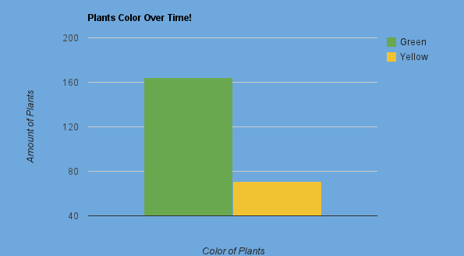
Laws of Motion

Slide 22
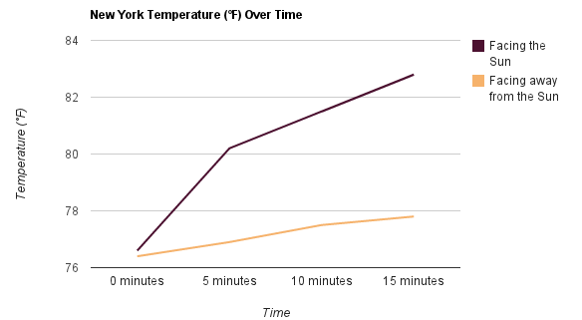
Laws of Motion

Slide 23
Laws of Motion
Task:
While viewing another group’s data table and graph, it will be your task to:
Write the Claim or Relationship
Provide Evidence explaining the Claim or Relationship
You will have 15 minutes

Slide 24
Laws of Motion
Essential Question: How do scientists analyze and interpret data results?
AIM: Background Knowledge
Date: March 13, 2013

Slide 25
Laws of Motion
In groups of 4,
Each member has been assigned a letter
A, B, C, or D
As you read the article, complete one of the graphic organizers OR write in your notebook
Be ready to share what you learned with your expert group.

Slide 26
Laws of Motion
In your expert groups:
Share what you learned with each other.
What information should your group share with your experiment groups?
Perhaps 4-5 ideas
Make sure each person is comfortable sharing this information

Slide 27
Laws of Motion
Sharing What You Learned:
Speakers
Each expert group will spend 5 minutes explaining their article
Be sure to allow time for other members to record what you share.
Audience Members:
Write any important ideas, concepts or words presented by each group.

Slide 28
Laws of Motion
A Title: Force & Newton’s Laws | B Title: Motion & Momentum
C Title: Newton’s 1st Law & Friction | D Title: Gravity, Weight & Mass

Slide 29
Laws of Motion
In your experiment groups:
Each expert (A, B, C, D) should spend 4 minutes sharing what they read.
Be sure to allow time for other members to record what you share.

Slide 30
Laws of Motion
Essential Question: How do scientists analyze and interpret data results?
AIM: Science Knowledge
Date: March 13, 2013

Slide 31
Laws of Motion
Task:
Use the information provided by your experts to explain the science concepts demonstrated in your data results.
Ex:
Why did the car with thin wheels go faster than the car with thick wheels?

Slide 32
Laws of Motion
Essential Question: How do scientists analyze and interpret data results?
AIM: Perfect Car Proposals
Date: March 13, 2013

Slide 33
Laws of Motion
Task:
Choose three variables tested by the class to design and build the PERFECT CAR.
Things to Consider:
How does each variable impact your speed?
What variables impacted the speed the most?

Slide 34
Laws of Motion
Tested Variable | Results | Suggestion

Slide 35
Laws of Motion
Essential Question: How do scientists analyze and interpret data results?
AIM: Race Day!!!
Date: March 13, 2013

Slide 36
Laws of Motion
Group | Average Speed
1
2
3
4
5
6

Slide 37
Laws of Motion
Task:
Create a Line Graph displaying the class data.
Provide a Claim & Evidence

